Slide 1
© Unicef/Ayene
© Unicef/Chakma
Activity 2
How does climate change
Affect children's rights?

Slide 2
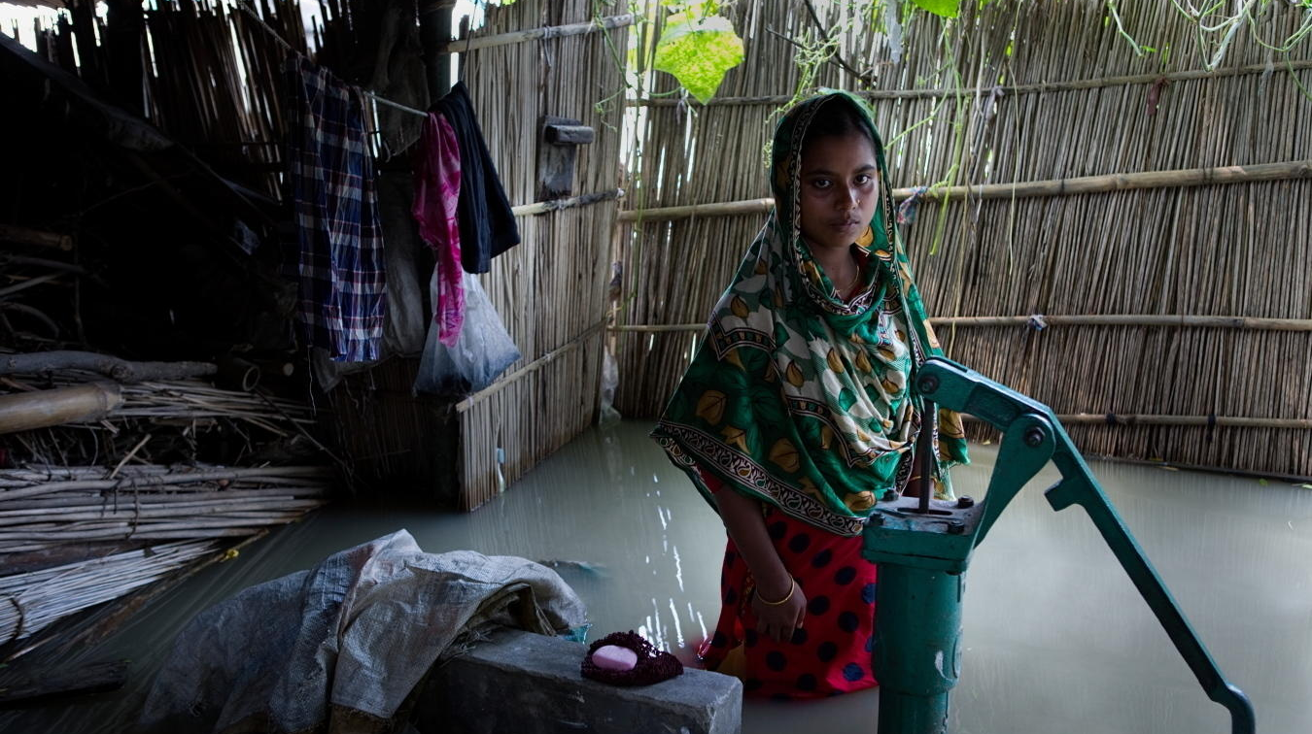
PART 1: rights summary
A young woman in Bangladesh, a country that floods frequently. © Unicef/Kiron

Slide 3
Article 12 (respect for the views of the child)
Every child has the right to express their views, feelings and wishes in all matters affecting them, and to have their views considered and taken seriously. This right applies at all times, for example, during immigration proceedings, housing decisions or the child’s day-to-day home life.

Slide 4
Article 13 (freedom of expression)
Every child must be free to express their thoughts and opinions and to access all kinds of information, as long as it is within the law.

Slide 5
Article 24 (health and health services)
Every child has the right to the best possible health. Governments must provide good quality health care, clean water, nutritious food and a clean environment and education on health and well-being so that children can stay healthy. Richer countries must help poorer countries achieve this.

Slide 6
Article 27 (adequate standard of living)
Every child has the right to a standard of living that is good enough to meet their physical and social needs and support their development. Governments must help families who cannot afford to provide this.

Slide 7
Article 28 (right to education)
Every child has the right to an education. Primary education must be free and different forms of secondary education must be available to every child. Discipline in schools must respect children’s dignity and their rights. Richer countries must help poorer countries achieve this.

Slide 8
Article 12
Article 13
Article 24
Article 27
Article 28
© Unicef/Brown
How do you think these five articles could be linked to climate change?

Slide 9
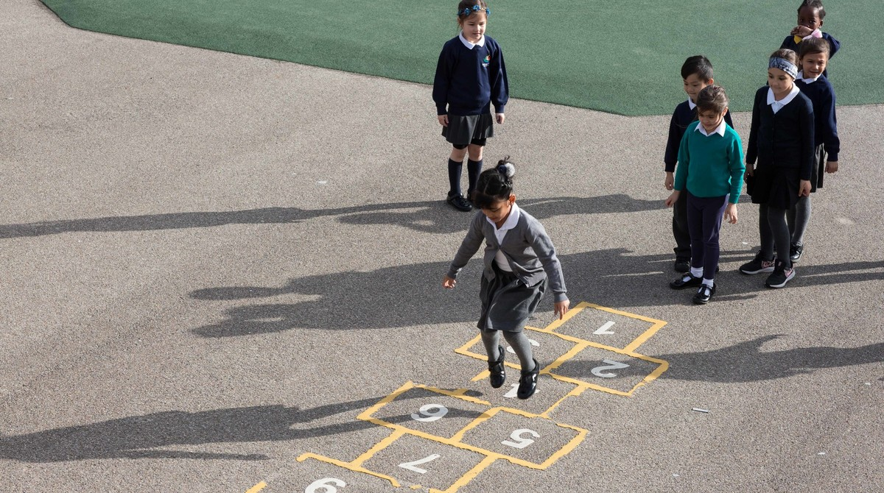
Part 2: It’s My Right – Activity Quiz
Do you know your rights?
© Unicef/Dawe

Slide 10
Until you are 18 years old, you are considered to be a child and all the rights of the UN’s Convention on the Rights of the Child apply to you.
TRUE
Or
FALSE
Notes:
True: The Convention considers anyone below the age of 18 to be a child.
Article 1 states that a child, and everyone under the age of 18, has all the rights listed in the Convention.

Slide 11
The UK government decides what my rights are as a child because this is where I live.
TRUE
Or
FALSE
Notes:
False: The lives of children may look different in every country, but children’s rights outlined in the Convention apply to all children no matter in which country they live – including the UK. The only country that has not ratified the convention is the United States of America, yet children’s rights are still recognised in the USA.

Slide 12
I have the same rights as all other children in the world to health, education and protection from harm.
TRUE
Or
FALSE
Notes:
True: The UNCRC guarantees rights for all children everywhere under the four categories of survival, participation, protection and development. A child’s right to health is protected under Article 24. A child’s right to education is under the category of development and is protected under Articles 28 and 29.

Slide 13
The government of the UK must also consider the rights of children in other countries because the actions of my country can also impact children in other places.
TRUE
Or
FALSE
Notes:
True: Child rights are for all children, everywhere. Many of the articles including Articles 24 and 28 state that richer countries must help poorer countries to achieve these rights – if a country is doing something that negatively affects a child’s right in another place, then they are not fulfilling their responsibilities as a duty-bearer.

Slide 14
It is my right to be loved, to have friends and to have access to the Internet to be able to find out important information.
TRUE
Or
FALSE
Notes:
False: Being loved, having friends and using the Internet are important, but they are not rights.
The articles in the convention help provide the conditions, resources, protections and freedoms that a child needs to grow up feeling happy and loved. Article 15, for example, ensures children the right to meet with their friends.
Likewise, Internet access isn’t a right, but access to information is. Article 17 says that every child has the right to reliable information from a variety of sources, and governments should encourage the media to provide information that children can understand.

Slide 15
I have a right to be educated about climate science and risks to my environment because this information is important for my health.
TRUE
Or
FALSE
Notes:
True: Article 17 says that children have the right to receive information that is important to their well-being. It also says that adults should help children find and understand the information that they need. Article 24 says that children have the right to access the information they need to stay well.

Slide 16
It is my right to ask my government to ensure that the environment is clean and healthy in order to protect my health and the health of other children.
TRUE
Or
FALSE
Notes:
True: Article 24 says it is the government’s job to provide a clean environment to ensure the good health of children, while Articles 12 and 13 protect a child’s rights to express their opinion and to have the government take their opinion seriously.

Slide 17
The government does not have to hear my opinion because I do not pay taxes.
TRUE
Or
FALSE
Notes:
False: The CRC protects a child’s freedom of expression. According to Article 13, every child must be free to express their views, feelings and wishes in all matters affecting them and to have their views considered and taken seriously, as long as it is within the law.

Slide 18
It is the UK government’s job to ensure that I have access to healthcare and education
– even during times like the coronavirus pandemic – because these are my rights.
TRUE
Or
FALSE
Notes:
True: Children’s rights are the same during times of peace and times of emergency. Article 24 protects a child’s right to health, Article 28 protects the right to education, and Article 27 protects the right for all children to have a standard of living that supports a child’s physical and social development.

Slide 19
Having access to clean water, nutritious food and a safe home are all rights for children that are threatened by global warming and climate change.
TRUE
Or
FALSE
Notes:
True: Having access to a clean and healthy environment and a good standard of living are rights for all children including children whose homes and lives are threatened by climate change (Articles 24, 27). We are highlighting children affected by climate in OutRight because these children are most at risk of losing these rights.

Slide 20
© Unicef/Dawe

