Slide 1
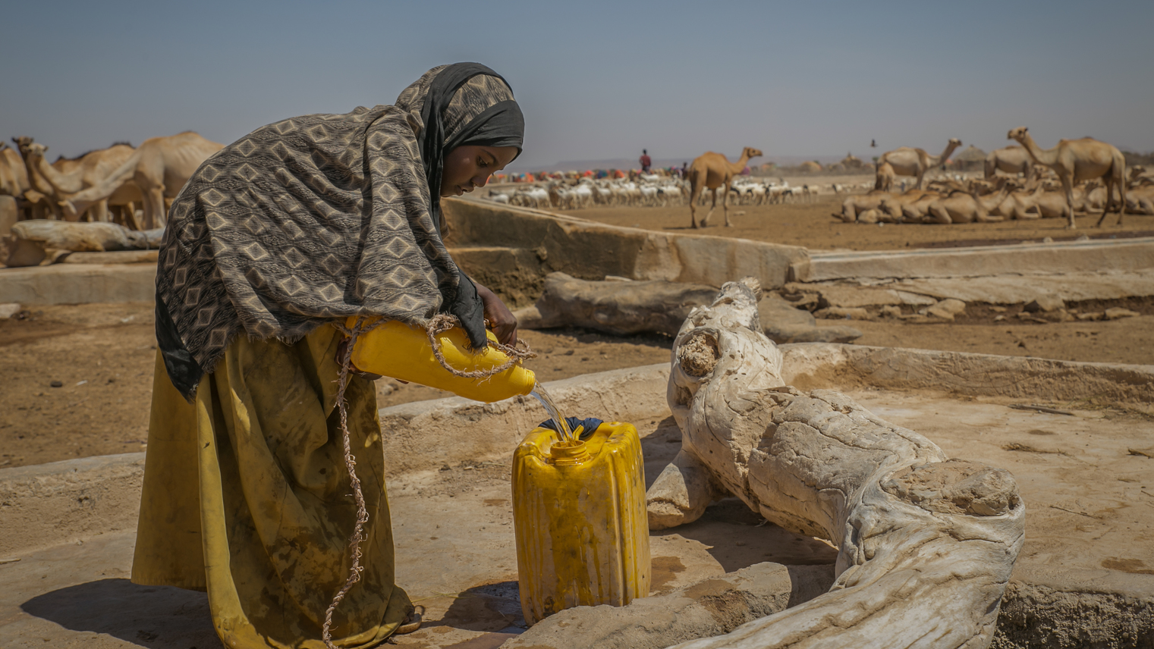
ACTIVITY 7
Education for a better future
Nine-year-old Sulem fills up a jerry can, helping her family to gather water in her village in Ethiopia. © Unicef/Ayene
Notes:
Introduce children to the activity, reminding children to wear their “explorer hat” from Activity 4.
Instruct children to create their own explorer diary by folding two A4 pieces of paper in half and securing them together at the fold.
Encourage children to decorate the cover of their diary with pictures that inspire them to learn about the world – something like a drawing of Paddington’s suitcase that he carried when he travelled from Peru to London.
We are going to meet four new friends in this lesson who are all Youth Advocates on Climate Change; so you will need to create four pages in your diary to write what you learn about them. On each page, write the following headings:
Name of the Youth Advocate or Group:
Home country:
What is interesting about them:
How has climate change impacted their right to health, education and home?
How are they using their voice for change? What is their message?

Slide 2
PART 1
Create an explorer's diary
Notes:
Introduce children to the activity, reminding children to wear their “explorer hat” from Activity 4.
Instruct children to create their own explorer diary by folding two A4 pieces of paper in half and securing them together at the fold.
Encourage children to decorate the cover of their diary with pictures that inspire them to learn about the world – something like a drawing of Paddington’s suitcase that he carried when he travelled from Peru to London.
We are going to meet four new friends in this lesson who are all Youth Advocates on Climate Change; so you will need to create four pages in your diary to write what you learn about them. On each page, write the following headings:
Name of the Youth Advocate or Group:
Home country:
What is interesting about them:
How has climate change impacted their right to health, education and home?
How are they using their voice for change? What is their message?

Slide 3
PART 2: Meet Unicef Youth Climate Advocates
Youth Advocate Profile #1 — ThOMPSON FROM ZAMBIA
Eighteen-year-old Thompson Manda is a climate ambassador in the southern Africa country of Zambia.
As a climate ambassadors, young people like Thompson learn about their environment and effects of climate change. They also learn about how to work with their community and government leaders to call on them to take climate change seriously.
Climate ambassadors like Thompson work on many creative and innovative projects. They know their voices as young people matter and they use them to help spread awareness about climate change, as well as to create innovative climate solutions.
“As a result of being a climate ambassador I want to study Civil Engineering so that I can find eco-friendly solutions and ways of adapting to the effects of climate change,” says Thompson.
Climate ambassador Thompson Manda from Zambia. © Unicef/Maseko

Slide 4
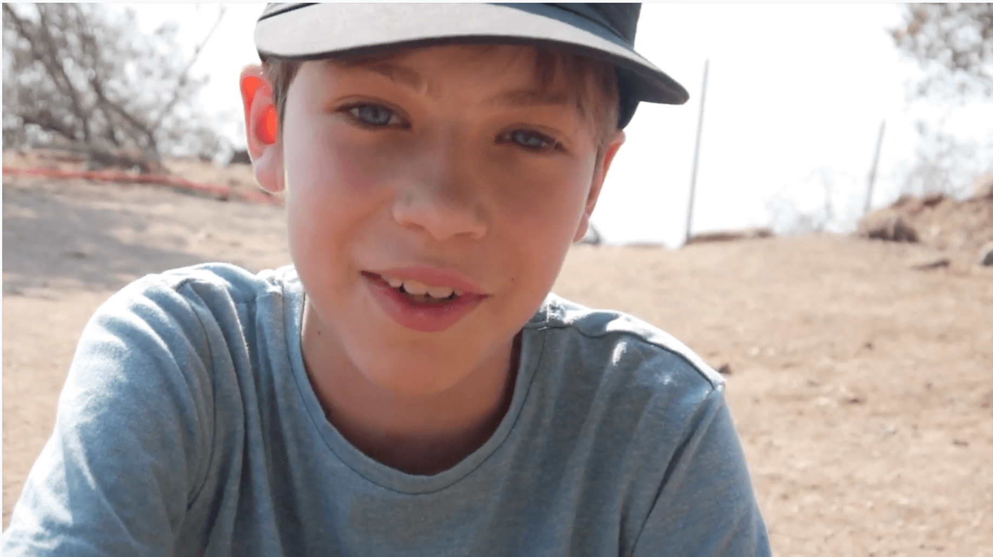
Youth Advocate Profile #2 — Dante FROM CHILE
Dante Vergara is an 11-year-old boy from the South American country of Chile. He has always loved nature since he was very young. In 2014 Dante decided to share this love for nature by starting a YouTube channel called Bichologia (bug-ology) following the motto, “In order to care for nature we must know and learn about it”. Dante’s YouTube channel features his findings from hikes in the Andes Mountains and national parks of Chile and has grown to have millions of viewers.
Dante uses his channel not only to share his love for nature, but also to raise awareness among other children about the importance of protecting biodiversity and the direct threat that climate change poses to their habitats.
Source: YouTube/UNICEF Chile
© Unicef/McIlwaine

Slide 5
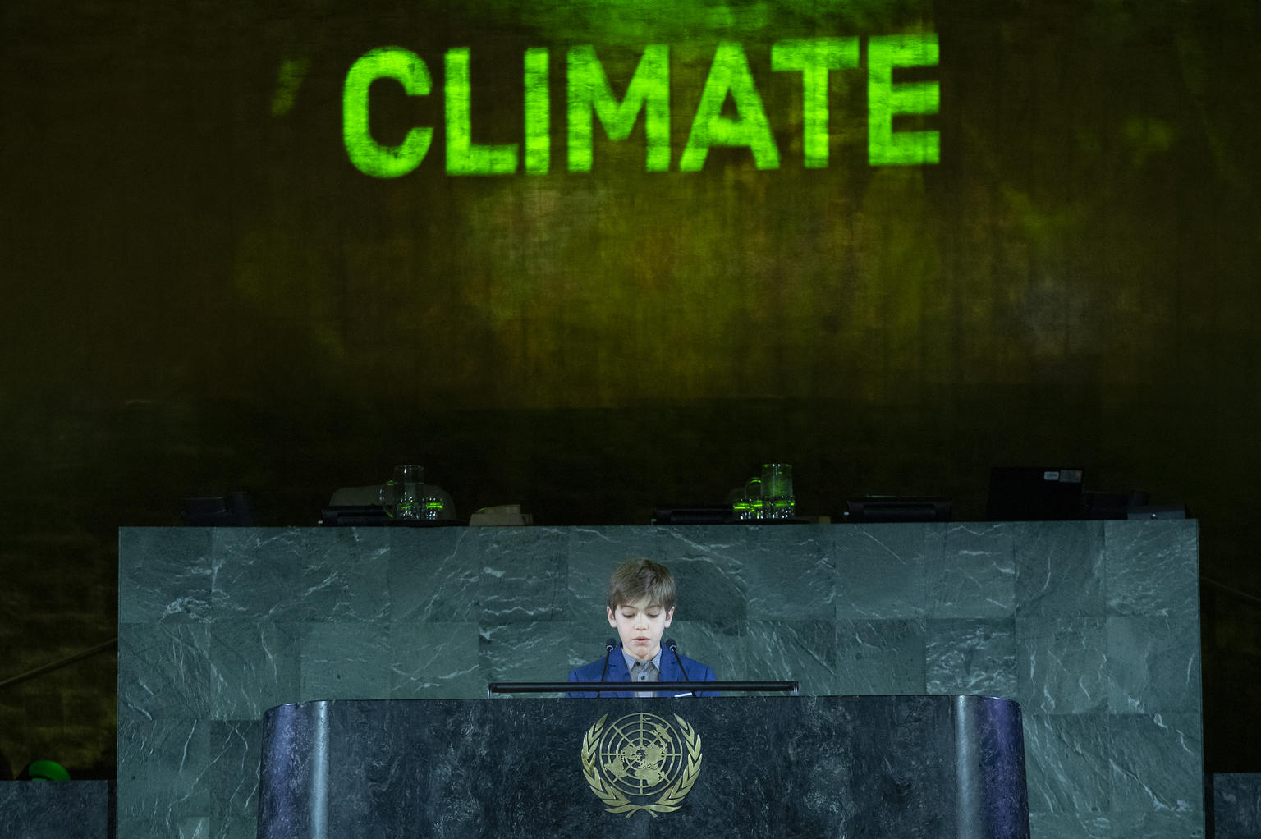
In addition to his own YouTube channel, Dante also uses his voice to ensure many other children have access to education about the environment by sharing his conservation messages in news outlets and through other educational environments.
One very important place that Dante got to share his message was at a global summit at the United Nations Headquarters in New York – joining children and young people from all over the word to demand action to protect and promote child rights, including the right to education, so no child is left behind.
Dante, 11, addresses a global summit at United Nations Headquarters in New York. © Unicef/McIlwaine

Slide 6
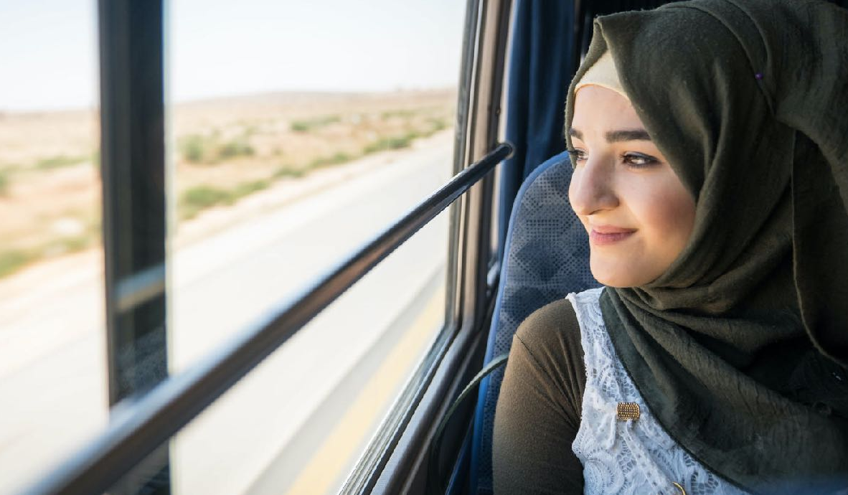
Youth Advocate Profile #3 — SIBA, Za’atari Refugee Camp
Eighteen-year-old Siba is one of the more than 20,000 children and youth living in the Za’atari Refugee Camp in Jordan. While the children here are primarily refugees as a result of the conflict in Syria, rather than climate migration, they know what it is like to live in very difficult circumstances. They are taking action to create solutions through a social innovation lab programme.
In 2018, Siba and more than 100 young people from the camp came together to participate in a startup event. These young people came to learn new skills in order to help create a better future.
Siba, 18, on her way from the Za’atari Refugee Camp in Jordan to share innovative solutions to climate change. © Unicef/Herwig

Slide 7
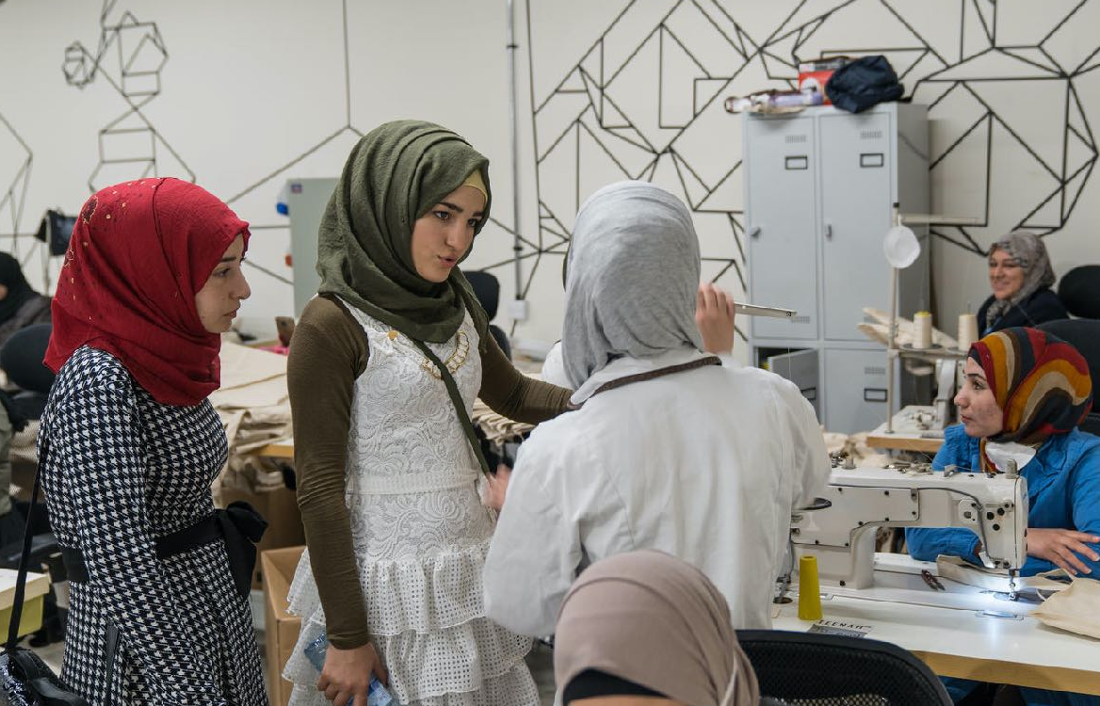
The young people take lessons in topics like robotics, creative visioning, fashion design and artificial intelligence, then come together to identify problems that they face in their community and design and create prototypes of inventions or programmes that address the problems.
Some of the innovations created to date include solar-powered phone chargers, water distilleries, reading lamps made from recycled materials, a gas-powered oven and a medicine cooler made of recycled materials.
Not only is education a right for children, it is one of the most valuable tools that children have to gain the tools they need to fight climate change for the long term and build a better future.
Siba, 18 years, talks to Abrar, 25 years, in Teenah, the social enterprise employing Syrian and Jordanian women hosted in the Fab Lab. © Unicef/Herwig

Slide 8
PART 3
Video and Discussion
Climate change activist Greta Thunberg speaks at a demonstration in New York. © Unicef/Chalasani
Notes:
Introduce children to the activity, reminding children to wear their “explorer hat” from Activity 4.
Instruct children to create their own explorer diary by folding two A4 pieces of paper in half and securing them together at the fold.
Encourage children to decorate the cover of their diary with pictures that inspire them to learn about the world – something like a drawing of Paddington’s suitcase that he carried when he travelled from Peru to London.
We are going to meet four new friends in this lesson who are all Youth Advocates on Climate Change; so you will need to create four pages in your diary to write what you learn about them. On each page, write the following headings:
Name of the Youth Advocate or Group:
Home country:
What is interesting about them:
How has climate change impacted their right to health, education and home?
How are they using their voice for change? What is their message?

Slide 9
To prompt thinking around the connection between the coronavirus pandemic and the climate crisis. Watch online here
Notes:
Introduce children to the activity, reminding children to wear their “explorer hat” from Activity 4.
Instruct children to create their own explorer diary by folding two A4 pieces of paper in half and securing them together at the fold.
Encourage children to decorate the cover of their diary with pictures that inspire them to learn about the world – something like a drawing of Paddington’s suitcase that he carried when he travelled from Peru to London.
We are going to meet four new friends in this lesson who are all Youth Advocates on Climate Change; so you will need to create four pages in your diary to write what you learn about them. On each page, write the following headings:
Name of the Youth Advocate or Group:
Home country:
What is interesting about them:
How has climate change impacted their right to health, education and home?
How are they using their voice for change? What is their message?

